Slide 1
CONTENTS
Data Structure Metrics :
Software Planner :
INPUT (Size, No. of developers and duration )
INTERNAL DATA ( Rate per developers and other factors)
DATA OUTPUT ( Project Effort, Duration and Estimated Cost)

Slide 2
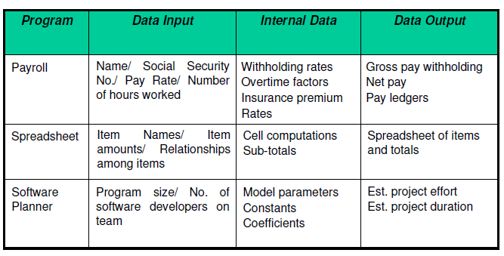
Data Structure Metrics
Fig.1: Some examples of input, internal, and output data

Slide 3
The Amount of Data
One method for determining the amount of data is to count the number of entries in the cross-reference list.
A variable is a string of alphanumeric characters that is defined by a developer and that is used to represent some value during either compilation or execution.

Slide 4
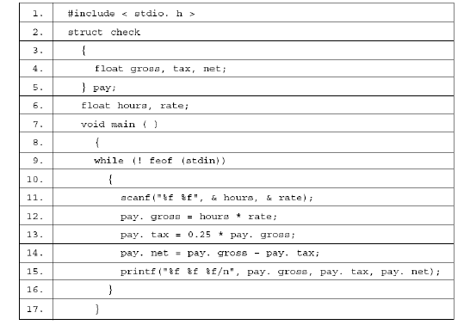
Fig.2 : Payday program

Slide 5
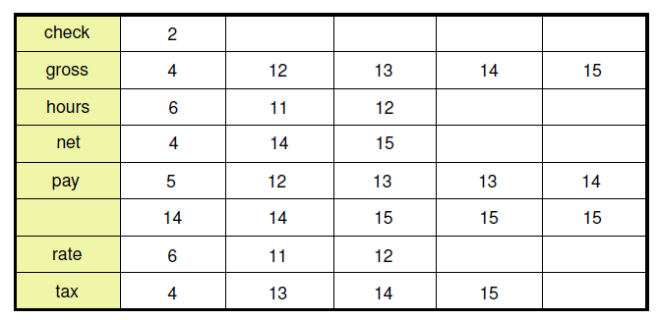
Fig.3: A cross reference of program payday

Slide 6
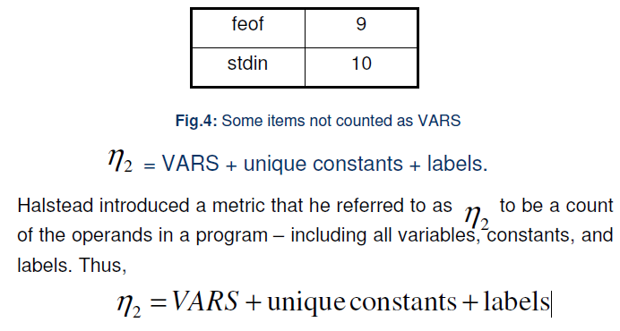

Slide 7
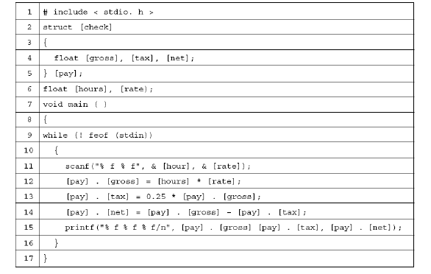
Fig. 6: Program payday with operands in brackets

Slide 8
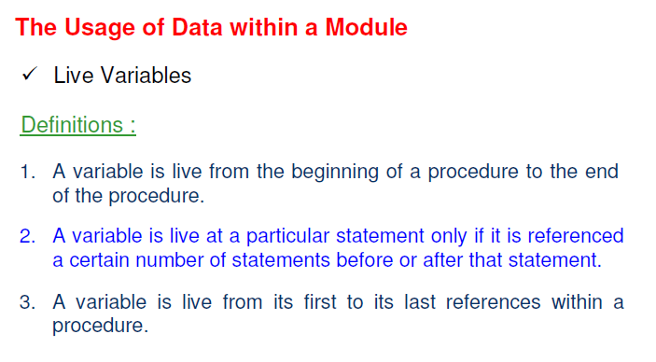

Slide 9
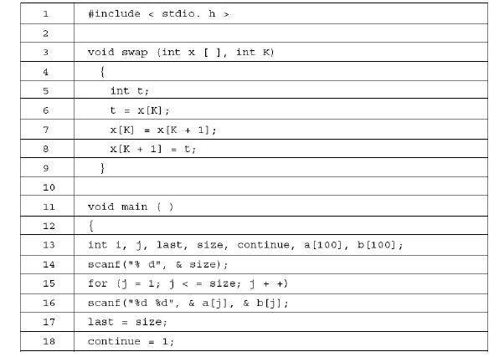

Slide 10
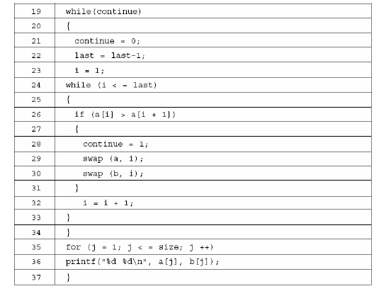
Fig.6 : Bubble sort program

Slide 11
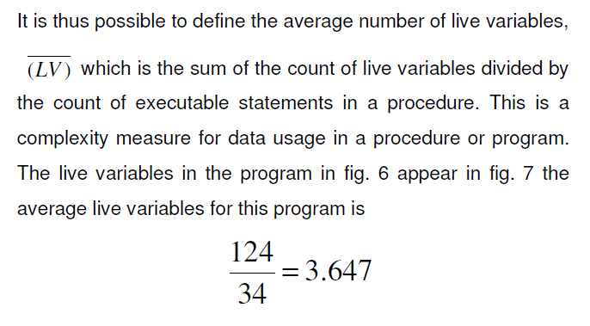

Slide 12
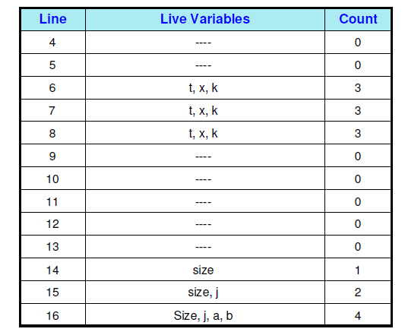

Slide 13
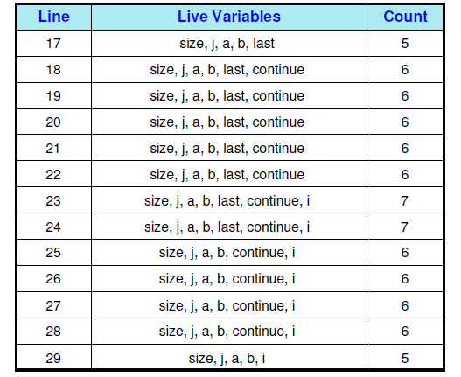

Slide 14
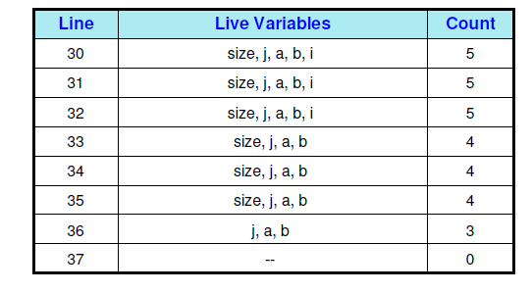
Fig.7: Live variables for the program in fig.6

Slide 15
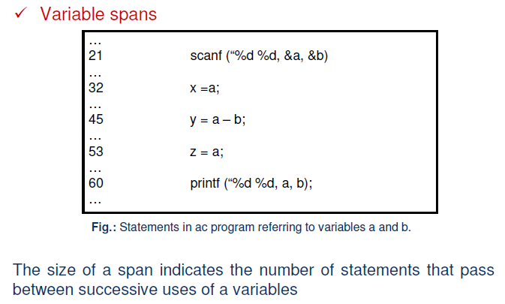

Slide 16
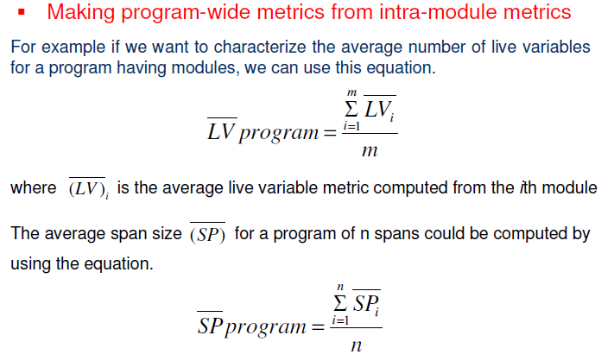

Slide 17
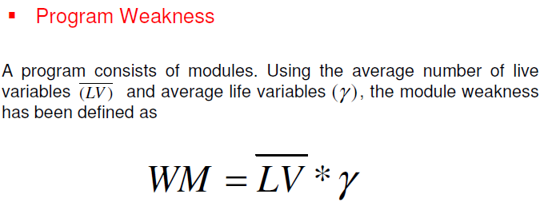
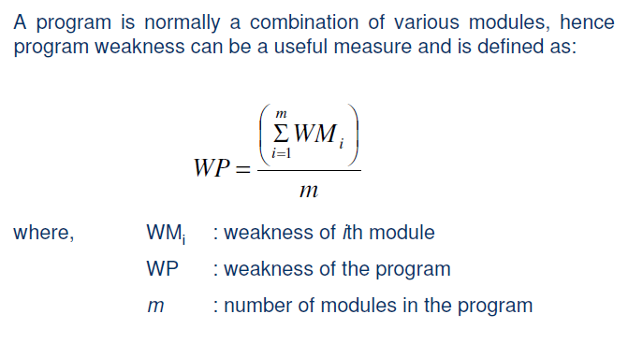

Slide 18
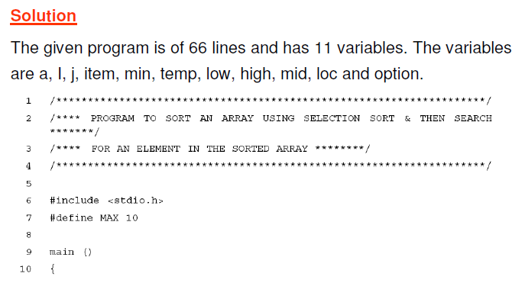
Example-3
Consider a program for sorting and searching. The program sorts an array using selection sort and than search for an element in the sorted array. The program is given in fig. 8. Generate cross reference list for the program and also calculate and WM for the program.

Slide 19
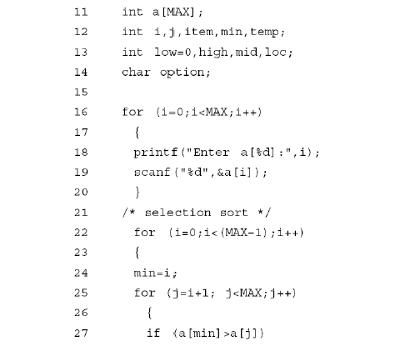

Slide 20
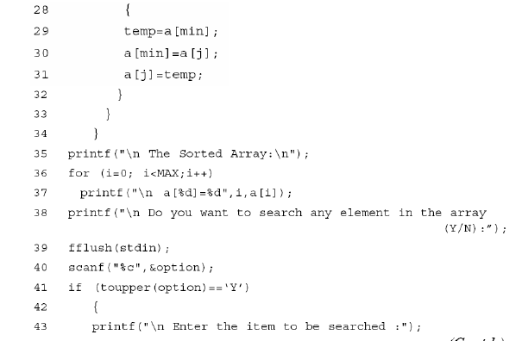

Slide 21
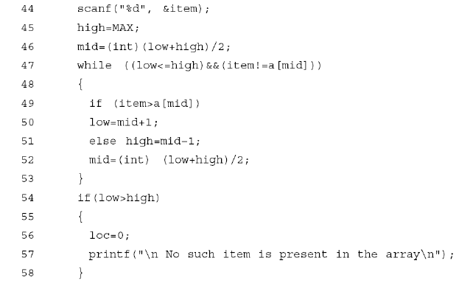

Slide 22
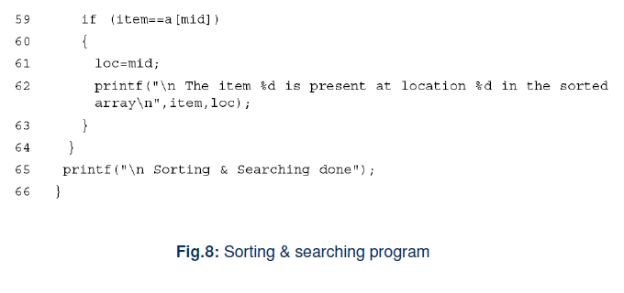

Slide 23
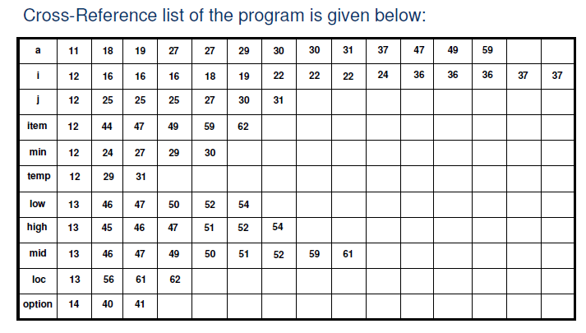

Slide 24
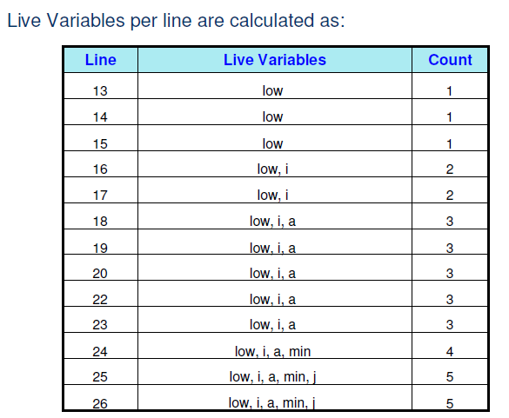

Slide 25
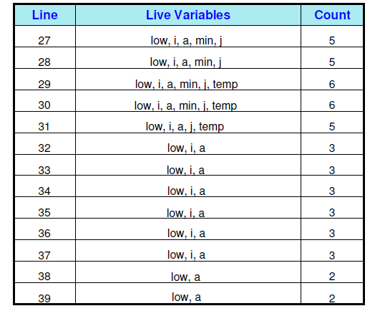

Slide 26
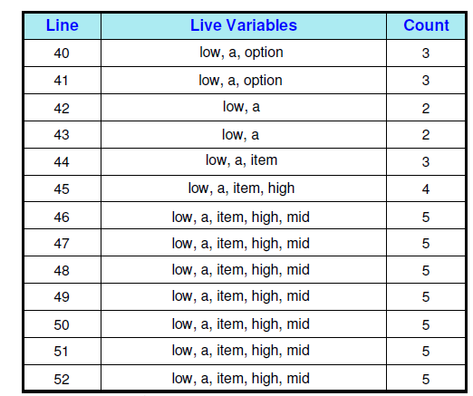

Slide 27
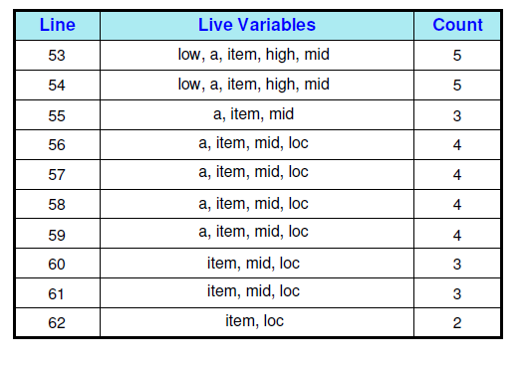
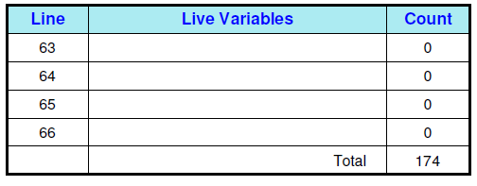

Slide 28
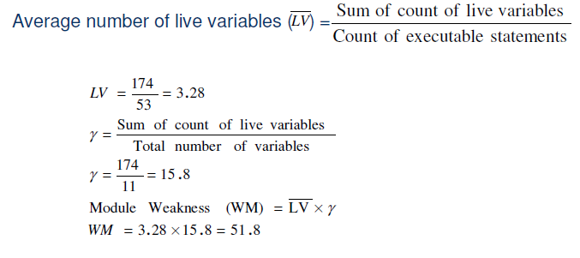

Slide 29
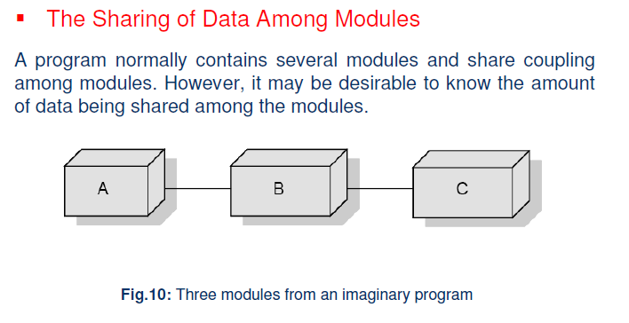

Slide 30
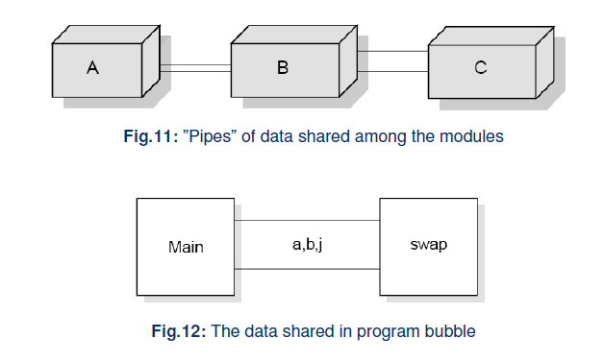

Slide 31
QUESTIONS
Q-1. Define data structure metrics?
Q-2. How can we calculate amount of data in a program?
Q-3. Describe the concept of module weakness. Is it applicable to programs also?
Q-4. What are Live variables?
Q-5. Discuss the significance of data structure metrics during testing.

Slide 32
THANK YOU

